Slide 1


Progress Report: 7
Team Charlie
Aakansha Bhatt, Anshu Paudyal, Ingmar Diaz, Michael Foster, Raunaq Chopra, Yang Ye
18th Feb 2021

Slide 2
Teamwork via zoom
Have to do:
Update the milestone for the Beta prototype

Slide 3
Aakansha Bhatt
Last week 6 | This week 7
Hardware: N/A | Hardware: N/A
Mechanical: Completed 3D enclosure | Mechanical: N/A
Firmware: Talked with the group about changing the sensor | Firmware: This week I had 4 midterms and couldn’t work on the project. Next week, I will be working on figuring out the sensors needed for measuring soil moisture and humidity, etc.
Software: same as above | Software: N/A

Slide 4
Anshu Paudyal
Week 7
Hardware:
Tomorrow and weekend
Try out different values of capacitor for the solar rover
Test the new H-bridge using the ADALM

Slide 5
Ingmar Diaz
Last week 6 | This week 7
Hardware: Finished Altium Breakout Board with Raunaq | Hardware:
Mechanical: Created a 3D enclosure for our board with Akansha | Mechanical:
Firmware: Firmware: Researched New OLED’s Began coding firmware from OLED, Meeting with Aakansha and Michael Today 2/4. Also heading to OH today 2/4 Oled is displaying, now to develop and test code to display accelerometer data. | Firmware: Planning to start developing OLED display code for our display features this weekend Will need capacitors and resistors for analog circuit
Software:

Slide 6
Michael Foster
Last Week: 6 | This Week: 7
Hardware: N/a | Hardware: N/a
Mechanical:N/a | Mechanical:N/a
Firmware/Software: Spending my spare time researching and trying to figure out how to make a solar fuel gauge using the | I felt like I was getting somewhere in the software solar fuel gauge, but I had to step away due to being ill. I get my results back tomorrow or saturday for covid.
Psoc, and Psoc Software. Other classes and recent deadlines/quizzes have kept me really busy. Also researching functions for OLED. | Extremely hard to concentrate with this and haven’t been able to get any class work done.

Slide 7
Raunaq Chopra
Week 5:
Hardware: The altium design is complete as of this week (screenshot of our design is included on the next slide; the only steps remaining on the PCB design is to include component labels. Since this was completed shortly before the meeting, labels could not be added but will be present in the alpha prototype submission
Week 5:
Firmware and Software: Our main focus is on developing the code for a working speedometer using the LIS3DH accelerometer, to have it ready when the alpha prototype is due.

Slide 8
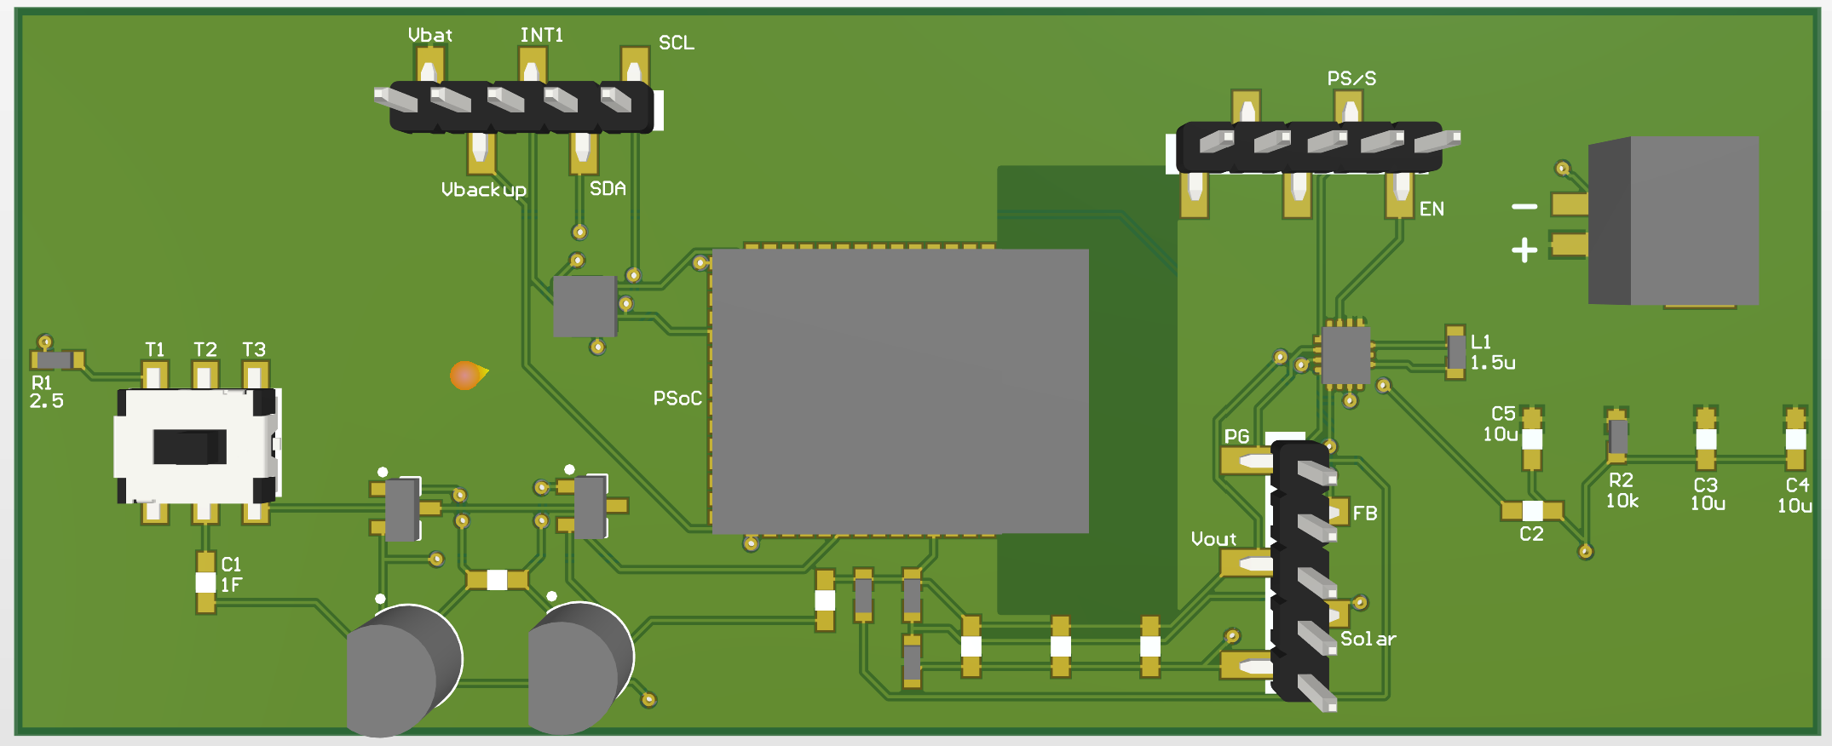
Raunaq Chopra

Slide 9
Yang Ye
Hardware: The video captured by the camera on the rover can be transmitted remotely to a receiver. The data stream will be then processed by the PC terminal. using OpenCV libraries)
Firmware: Setting up AV video signal converter
Software: Compiling OpenCV library.

Slide 10
Bill of Materials and Project Budget:
Rover Truck + Solar Panels +
SPDT switches + 10x*0.1F capacitors +
Box of capacitors +
shipping for Switches and cap = $87.42 + $13.00 + $8.28 + $18.39 + $13.39 ~ $140.48
Project Schedule and Risk Assessment: MILESTONES - Google Docs
Report and Presentation: 12th Feb 2021
Marketing and Video: 11th Feb 2021
Tips:
1. Be sure to identify tasks and contributions of each team member.
2. Use pictures as much as possible for effective communication.

